Slide 1
AIRLINE MARKET ANALYSIS TO IMPROVE NPS SCORE
Renjie Zhu
Chaoying Lyu

Slide 2
DATA PREPARATION
Mitigate Missing Data
FreeText：remove those missing values
Departure delay and arrival delay in minutes: replace with average
Flight time in minutes: replace with average

Slide 3
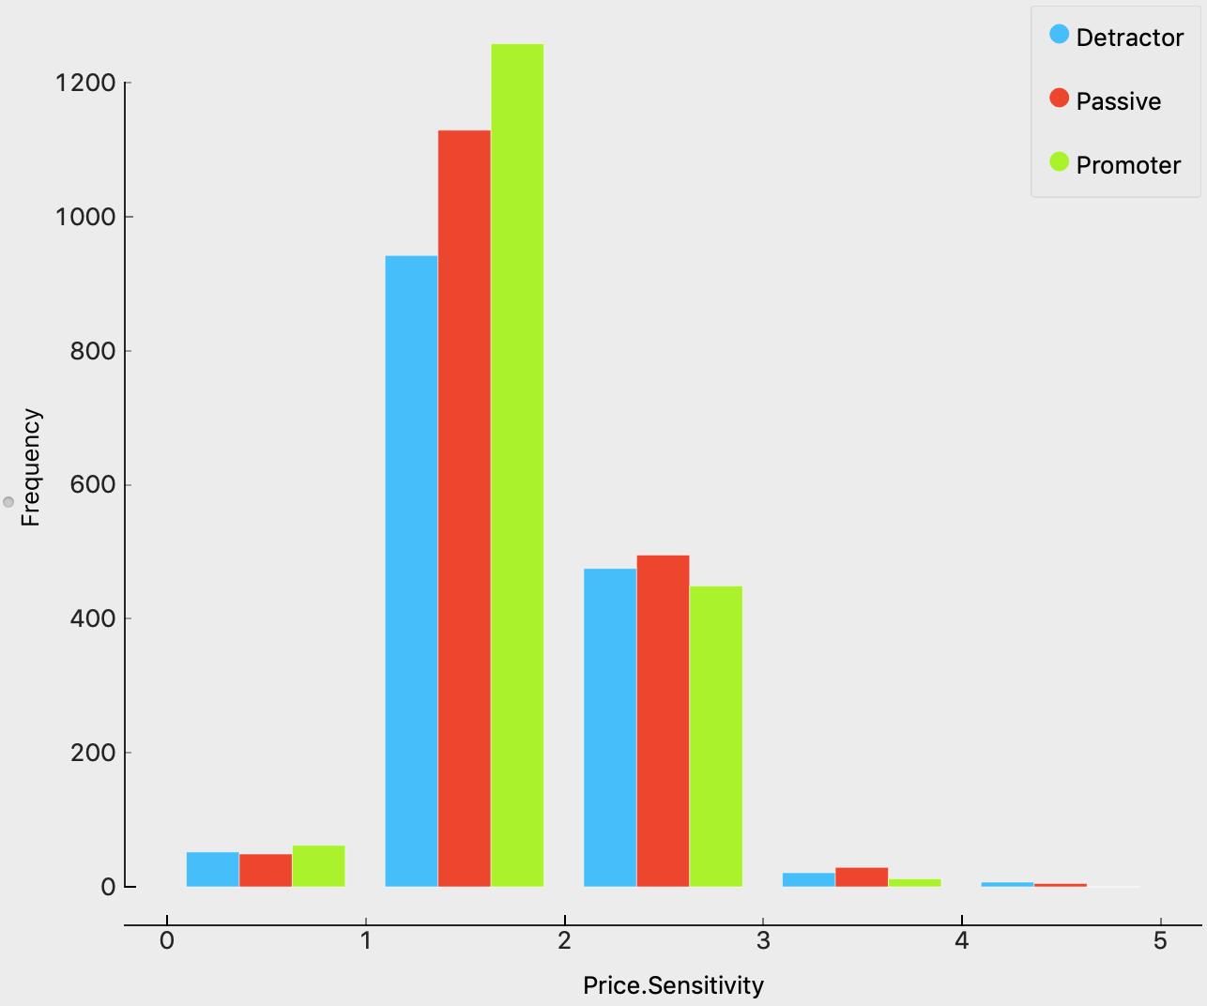
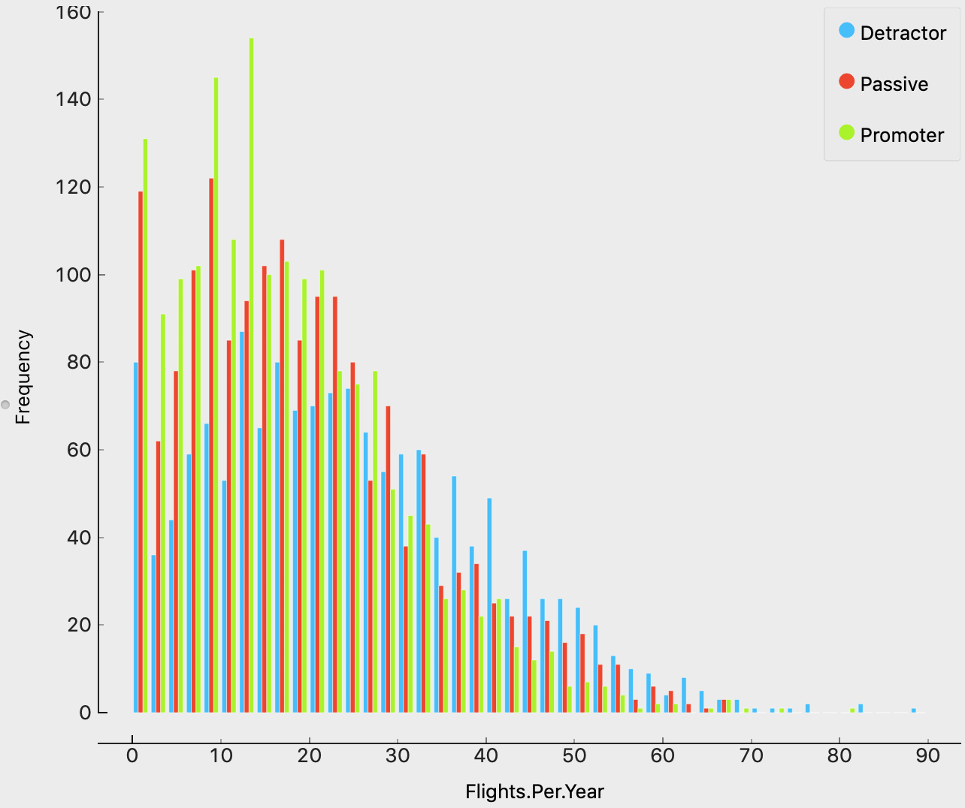
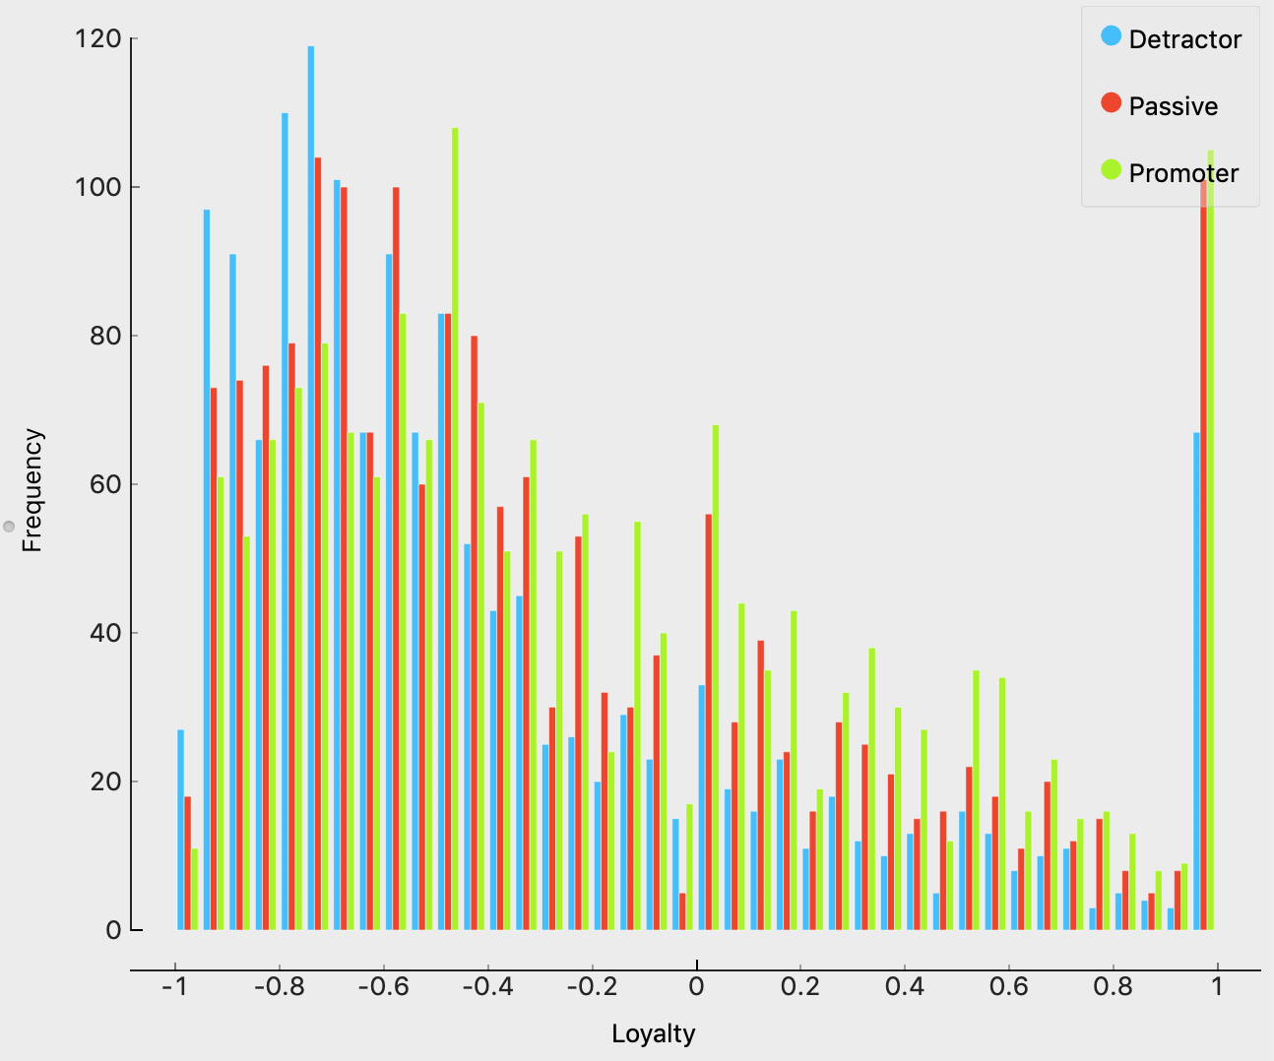
DATA PREPARATION
Summarize：
Price sensitive
The shape of histogram is positively skewed (long right tail), few people gave a 4 or 5 sensitivity score.
Few flights
most people had less than 40 flights per year
Low loyalty but Die-Hards
Most customer with low loyalty but considerable Die-Hards

Slide 4
Segment

Slide 5
DATA PREPARATION
Summarize：
few flight
most people had less than 40 flights per year
low loyalty but Die-Hards
Most customer with low loyalty but considerable Die-Hards

Slide 6
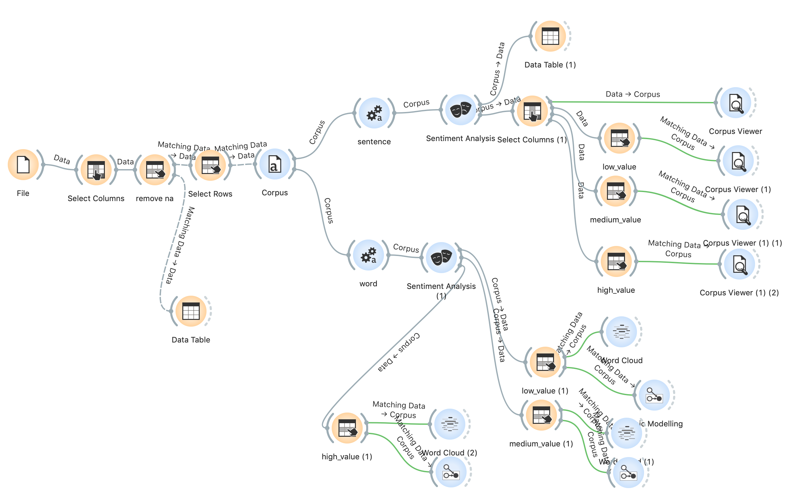
Sentiment Analysis

Slide 7
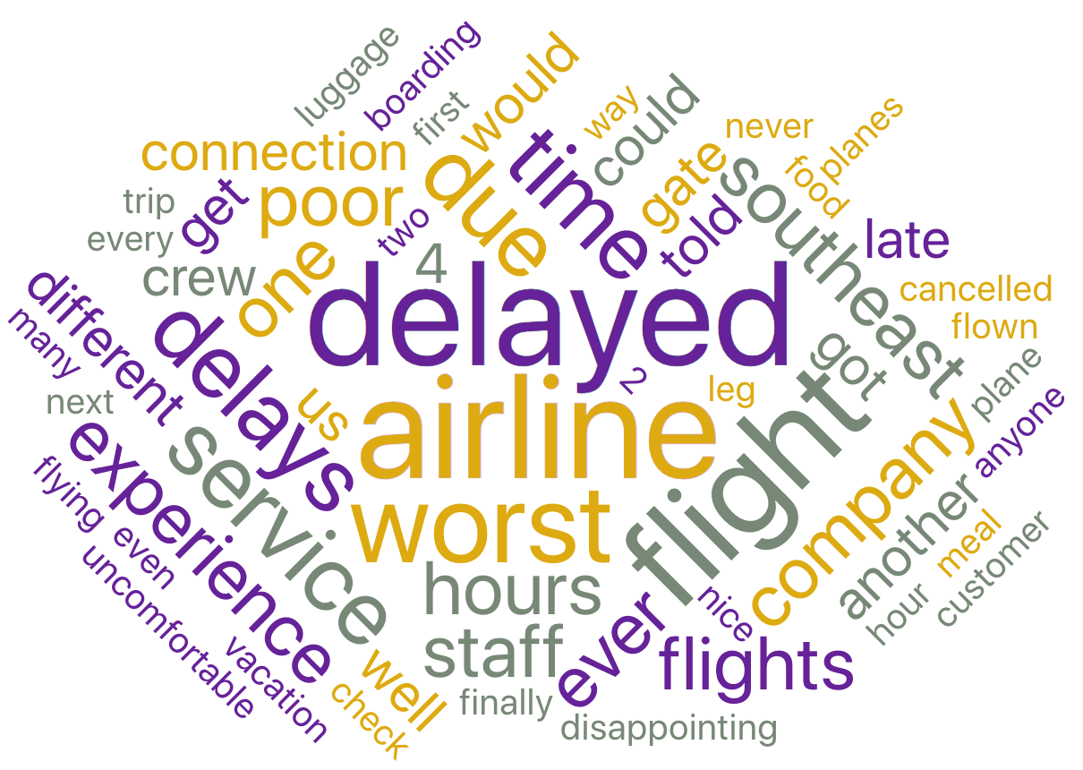
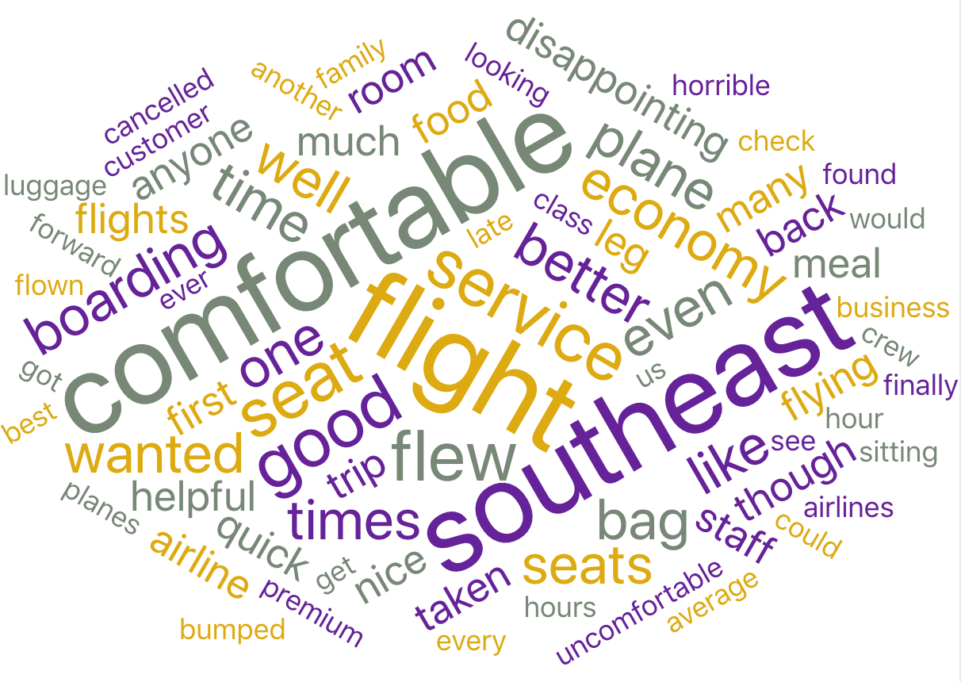
Cheapseats Airlines Comments
Complain：
delay
Uncomfortable
Food quality
Kudo:
Service
Economic

Slide 8
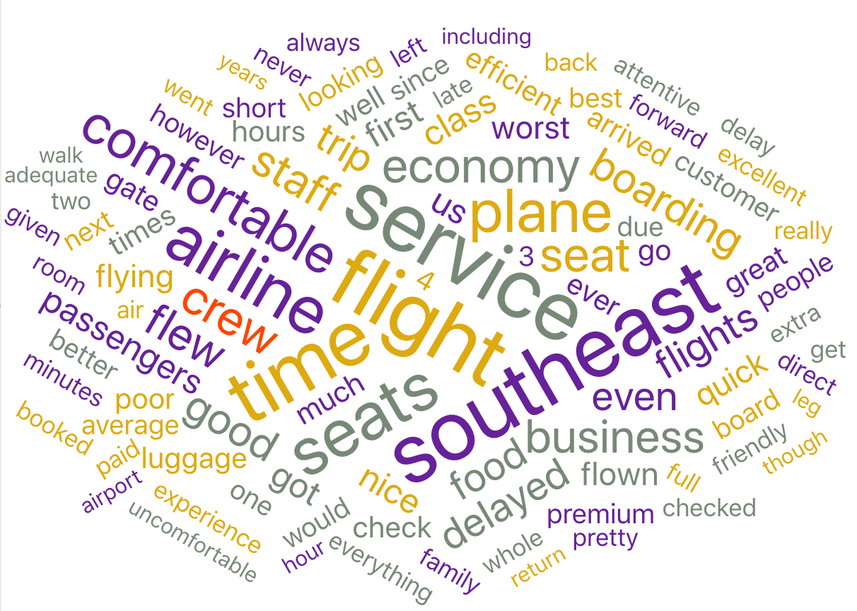
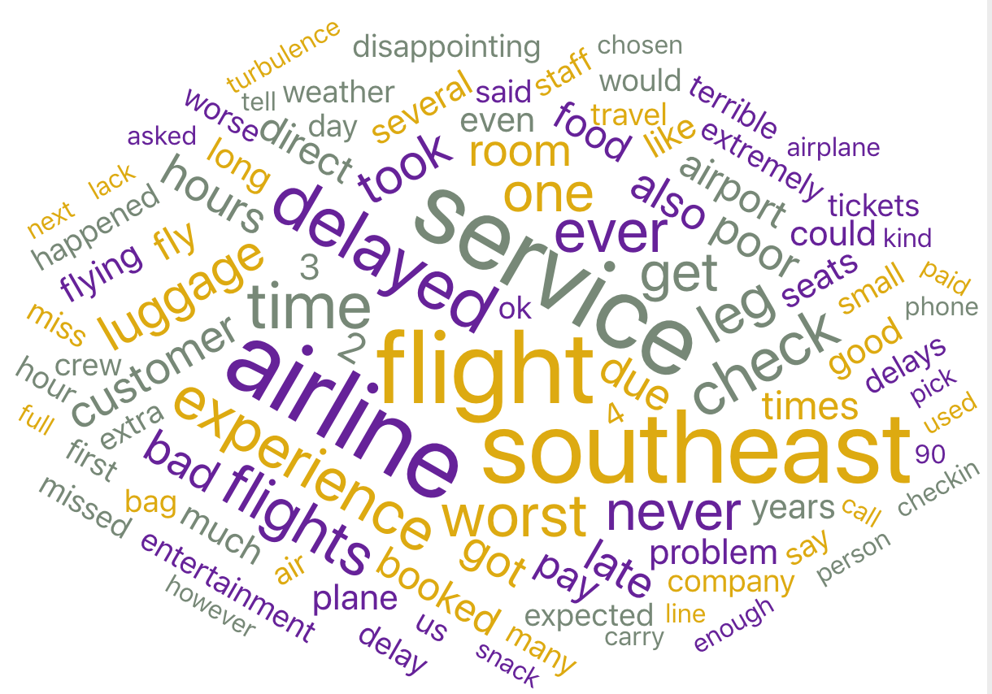
Other Partners Comments
FlyFast Airways ：
poor service and equipment
plane’s due arrival
Sigma Airlines Inc :
poor service
comfortable seat
without delay

Slide 9
Predictive Modeling
Random Forest
Naive Bayes
Support Vector Machine(SVM)
Support Vector Machine(SVM)
Neural Network

Slide 10
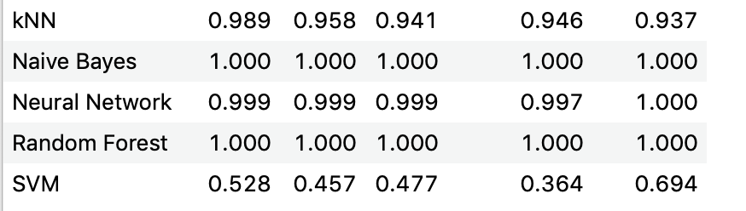
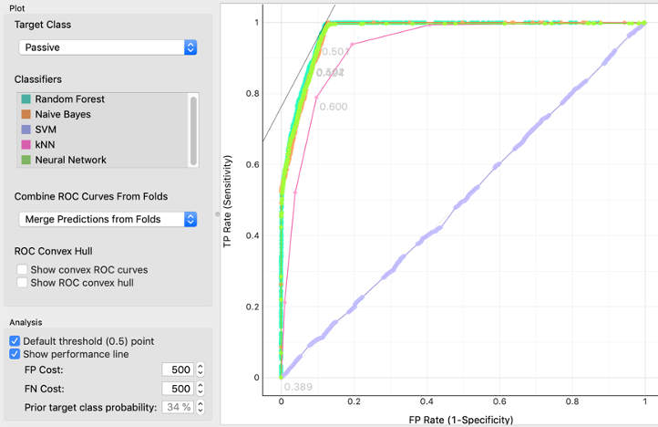
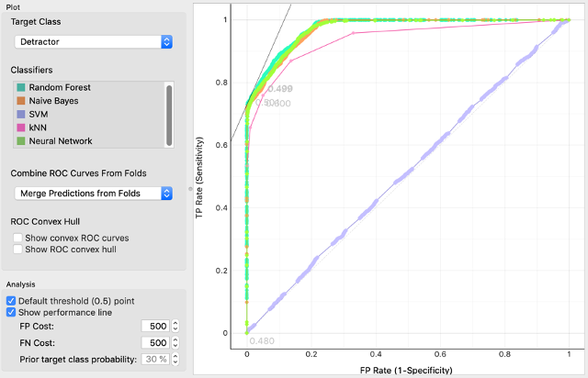
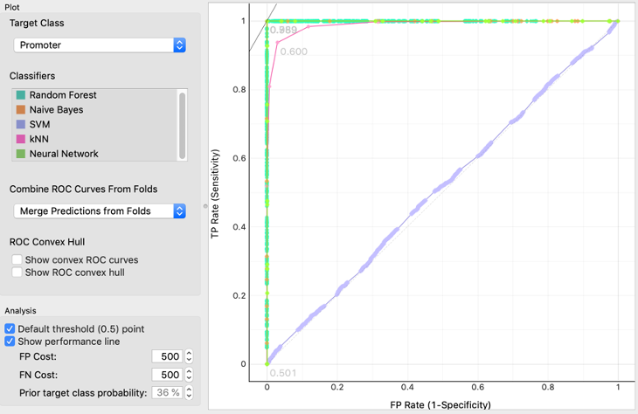
Result comparison
Detractor
Passive
Promoter
Based on the comparison, we chose the random forest model as our best predictive model to apply on the customer data since this model performs the best and it could help us gain insights about feature importance

Slide 11
BUSINESS RECOMMENDATIONS
Client:
FlyFast Airways Inc.
Problem
Low proportion of promoters
Detract Customer
Personal type of travel
large number of flights per year
Senior(age>60)
high price sensitivity
Female

Slide 12
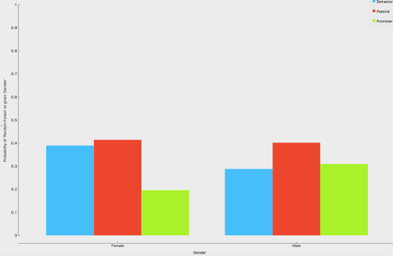
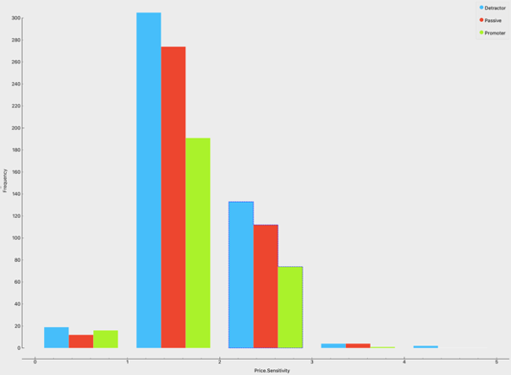
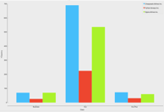
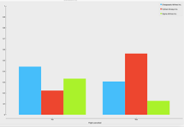
BUSINESS RECOMMENDATIONS
What need improve:
High price sensitivity customers of other Airways are more likely to be promoters. And those customers have higher loyalty scores.
Male and senior customers are more satisfied than FlyFast
Other Airways customers of Eco class gave higher NPS scores
Less cancelled flights

Slide 13
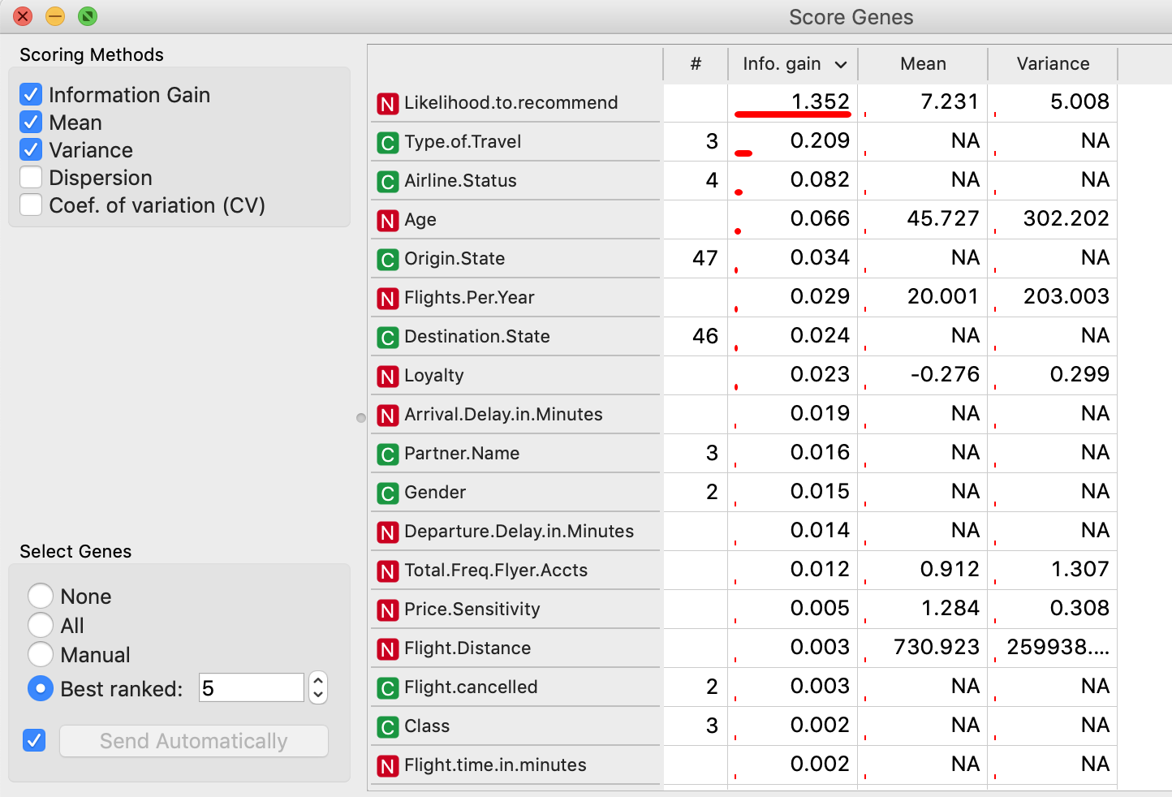
BUSINESS RECOMMENDATIONS
Improve
Gender
Price Sensitivity
Flight per year
ravel type

Slide 14
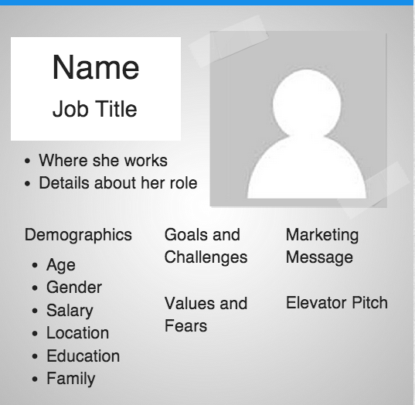
Segment Persona’s
Promoter
Age:32-44
Type of Travel : Personal travel
Gender : Female

Slide 15
Segment Persona’s
Detractor
Age:>=58
Type of Travel : Business
Delay : >28min

Slide 16
Segment Persona’s
Passive
Airline Status: Gold
Partner: FlyFast Airways Inc
Gender : Female

Slide 17
Market Plan
Do a further survey about the southeast
Improve the compensation standard for flight delays
Gave more coupon to personal eco class customers
Give free rides for the frequent visitors
Specific nice service to senior customers
Improve the service of cheap flights

